Slide 1

Predictive Modelling of Healthcare-Acquired Infections with RTLS Data & Graph Neural Networks
Rivyesch Ranjan

Slide 2


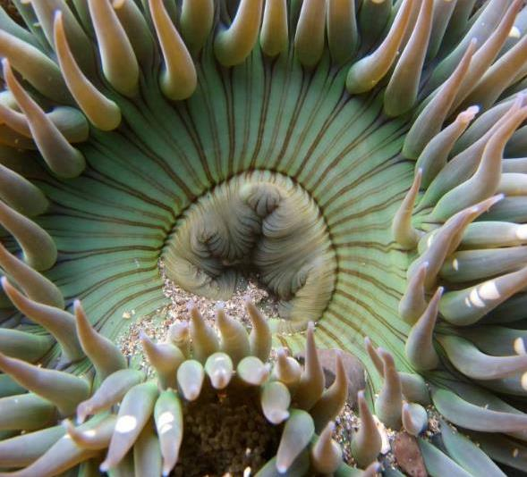

Agenda
Introduction​
Related Works
Methodology​
Results
Discussion​
​Future Works
Summary​

Slide 3
Introduction

Slide 4

Healthcare-Acquired infections (HAI)
Infections acquired during healthcare
Pose significant threats to patient safety and global public health
Estimated 300,000 cases annually in the UK
Cost of HAIs in the UK range between £328 million to £2.2 billion

Slide 5

Challenges in HAI Management
Despite medical advancements, managing HAIs remains challenging
Infection prevention and control (IPC) measures such as early identification and environmental control are pivotal but face implementation hurdles

Slide 6

Variability in clinical settings
Healthcare settings vary, impacting HAI risks, exposure routes and patient demographics
Understanding these differences is crucial for tailored intervention strategies

Slide 7

Research aims
To investigate the use of advanced data integration techniques for enhancing infection control practices within healthcare settings
To explore the potential of applying machine learning methods in the context of infection control within hospitals
To explore the adaptability and robustness of machine learning algorithms in the context of dynamic infection scenarios within healthcare environments
Notes:
Weighted consideration for loss
GCN: GCN convolutional layers
GAT: GAT convolutional layers with a specified number of heads
GraphSAGE: SAGE convolutional layers with number of samples parameters

Slide 8
Research questions
How can contact tracing and Real-Time Location Services (RTLS) data be effectively integrated to create predictive models for HAI transmission in healthcare settings?
What are the most suitable machine learning algorithms for modeling the spread of infections using the acquired data, and how do they compare in terms of accuracy and efficiency?
How sensitive are the machine learning algorithms to infection risk stochasticity and transmission route?
Notes:
Weighted consideration for loss
GCN: GCN convolutional layers
GAT: GAT convolutional layers with a specified number of heads
GraphSAGE: SAGE convolutional layers with number of samples parameters

Slide 9
Related Works

Slide 10
SIR Model
Compartmental model that captures disease transmission dynamics
Consider individuals as susceptible, infected or recovered
Governed by three coupled ordinary differential equations (ODEs)
Assumes homogeneous mixing of infected and susceptible groups, and a constant total population over time
Importance of combining mathematical models like SIR with secondary models for enhanced accuracy
Notes:
Susceptible (vulnerable), Infected (capable of transmitting), or Recovered (immune)

Slide 11
Machine Learning in Epidemiological Modelling
Three distinct models explored: linear regression, logistic function, and ARIMA
ML model exhibit limitations that stem from inability to explicitly capture spatial relationships in non-Euclidean data
Time series data, often complex with diverse correlations and intricate patterns, challenges traditional and machine learning methods
Majority of papers did a population level prediction
Emphasizing the need for tailored approaches based on context and data characteristics
Notes:
Most literature tends to focus on building contact networks instead of predictive techniques
Results tend to be focused on an aggregate perspective and not targeted/individuals

Slide 12
Graph Approaches in Disease Transmission Prediction
Solution to capturing spatial and temporal dependencies in complex time series data
Graph-based modeling approaches using GNNs: capturing higher-order neighborhood information without overfitting
Innovative approach incorporating graph structure directly into neural network model for semi-supervised or supervised learning.
Challenges in GNN adoption: memory resources, scalability for real-time applications, and transformation of data
Notes:
Susceptible (vulnerable), Infected (capable of transmitting), or Recovered (immune)

Slide 13
Methodology

Slide 14
Methodology Overview
Pre-processing
EDA
Epidemic Simulation
Data Transformation
modelling
Clean and subset the data
Understand and extract insights on the characteristics of the data
Generate labels using simple SIR model
Create temporal graph datasets from the structured tabular data
Use GCN, GAT and GraphSAGE to model the data and make predictions

Slide 15
Description of Data
Proximity data from NHS Manchester hospital
463,833,330 records over 3 week time period
Data has 5-minute resolution, hence 6048 timesteps
468 individuals
Stored in AWS database using SQL

Slide 16

Technologies and Libraries Utilised
Technologies:
Python, SQL, Amazon SageMaker
Libraries:
Pandas and Numpy
Matplotlib
MySQL Connector
Pytorch and Pytorch Geometric
Notes:
Cloud computing resources and GPU capabilities for efficient data processing.
Pandas and NumPy: Data manipulation and numerical operations.
Matplotlib: Data visualization and graphical representation.
MySQL Connector: Interaction with SQL database.
PyTorch and PyTorch Geometric: Essential for graph-based machine learning tasks.

Slide 17
Data Preprocessing
Indexing raw data for efficient SQL querying operations
Removal of symmetric duplicates for data integrity
Handling records with a distance value of 0 to ensure numerical stability
Temporal sorting of data
Subsetting strategy: smaller, representative sample for initial code development phase

Slide 18
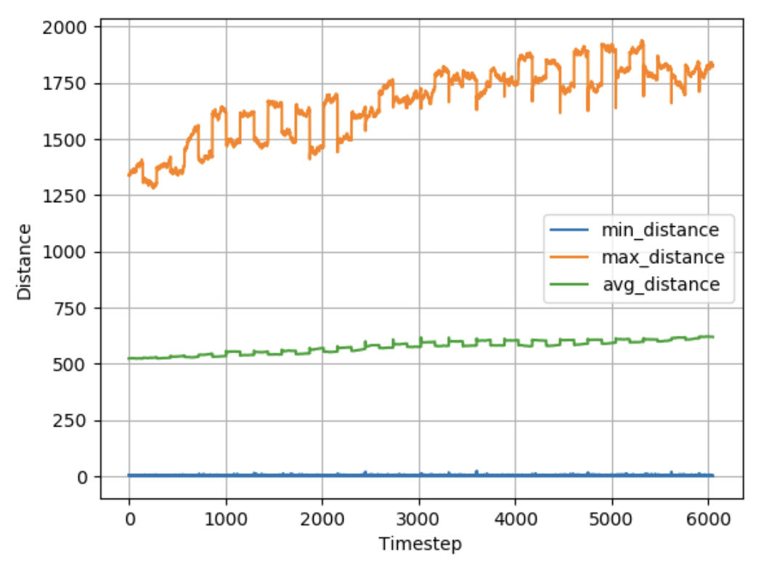
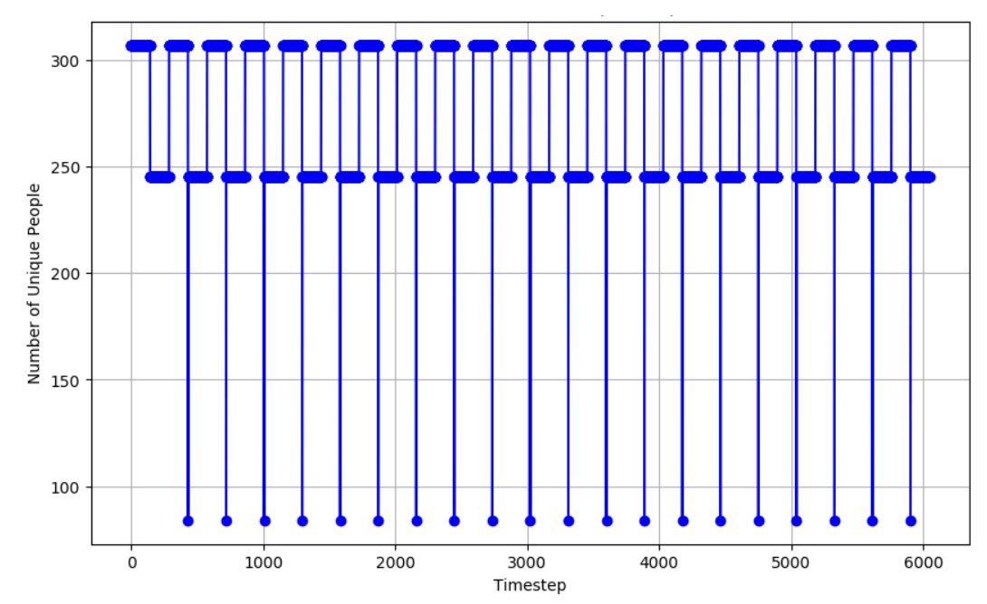
Exploratory Data Analysis (EDA)
Notes:
Hyperparameters optimized one at a time while others kept fixed for focused exploration.

Slide 19

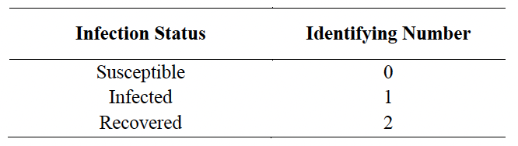
Epidemic Simulation
Simulation of infection transmission dynamics using SIR model
Initial infected individuals and corresponding recovery times selected randomly
Three simulation scenarios with varying total proportion of population infected
Simulation run for two weeks

Slide 20

Data Transformation
Graph created for each timestep
Node feature matrix, edge attribute, edge indices and target labels prepared
Graphs organized into sequential dataset

Slide 21
Splitting the graph dataset
Thoughtful division of dataset into training set (first 3744 graphs) and testing set (288 graphs)
Sequential split without shuffling to preserve temporal order, maintaining time series element
Batch size of 32 chosen for efficient training

Slide 22
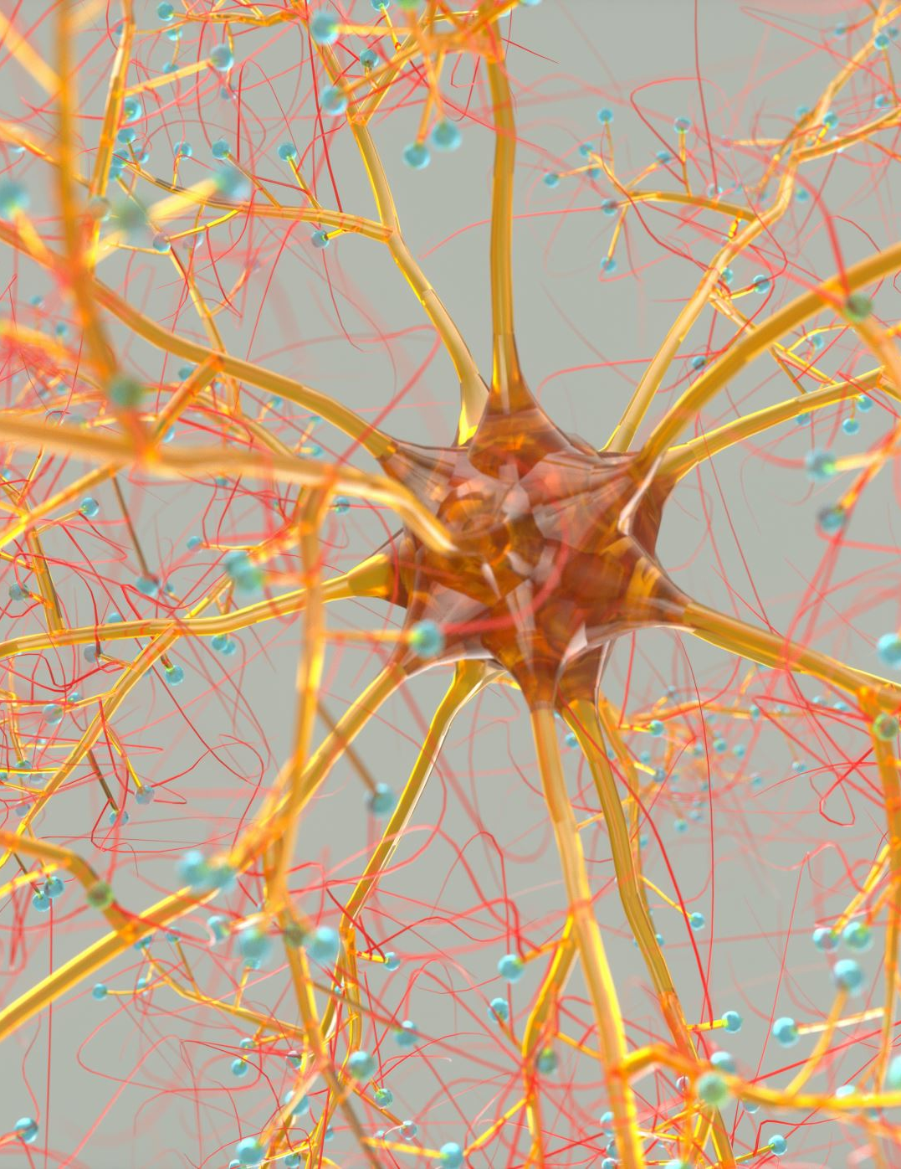
GNN Development
Custom two-layer network with ReLU activation and dropout layers.
Adam optimizer was used with a pre-specified learning rate and a BCEWithLogitsLoss loss function
Three architectures used: Graph Convolutional Network (GCN), Graph Attention Network (GAT) and GraphSAGE
Notes:
Weighted consideration for loss
GCN: GCN convolutional layers
GAT: GAT convolutional layers with a specified number of heads
GraphSAGE: SAGE convolutional layers with number of samples parameters

Slide 23
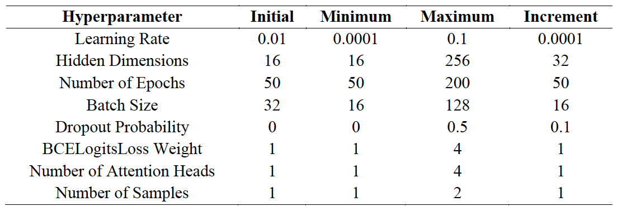
Hyperparameter Tuning
Key hyperparameters considered: Learning Rate (LR), Hidden Dimensions, Number of Epochs, Batch Size, Dropout Probability, Number of Attention Heads (for GAT), Number of Samples (for GraphSAGE).
Hyperparameters' impact on model behavior and performance carefully considered during tuning
Sequential grid search approach
Notes:
Hyperparameters optimized one at a time while others kept fixed for focused exploration.

Slide 24

Performance Evaluation Metrics
True Positive (TP), True Negative (TN), False Positive (FP) and False Negative (FN) derived from confusion matrix
Accuracy, Specificity, Sensitivity and F1-score used to characterize model performance
Metrics used tailored to the classification nature of the project
Notes:
F1-Score used to capture a balance between Precision and Sensitivity, considering the trade-off between Sensitivity and Specificity

Slide 25
Results

Slide 26
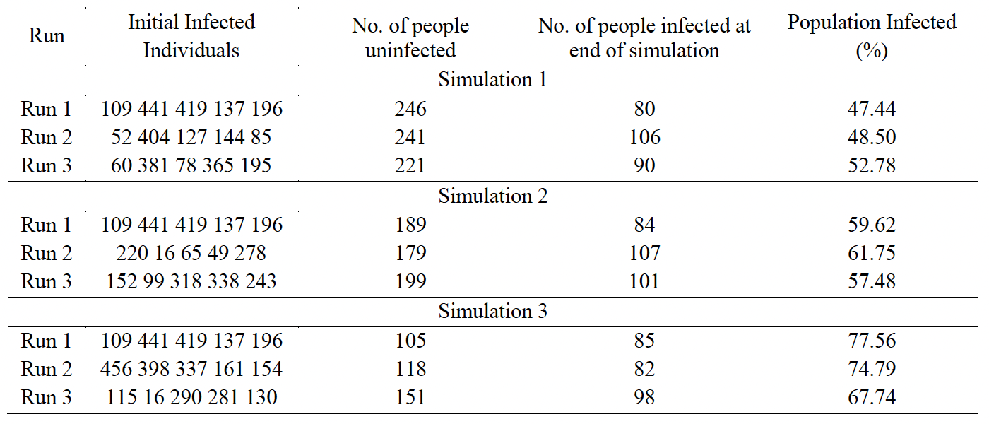
Overview of Labels Generated for the Three Simulations
Notes:
Hyperparameters optimized one at a time while others kept fixed for focused exploration.

Slide 27
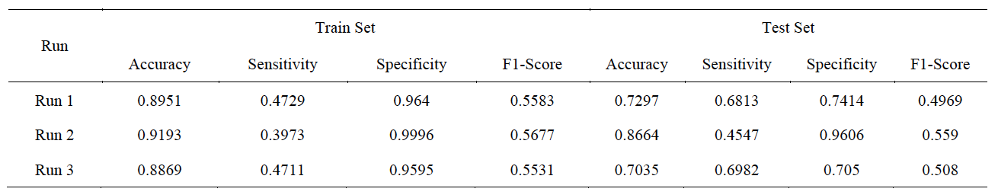
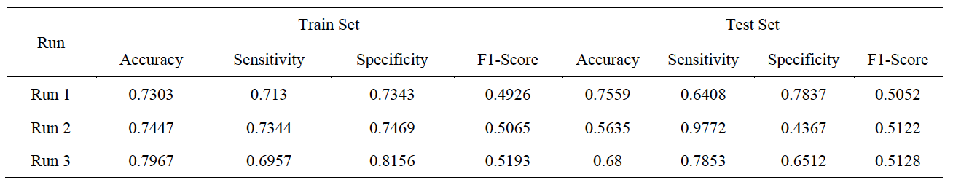
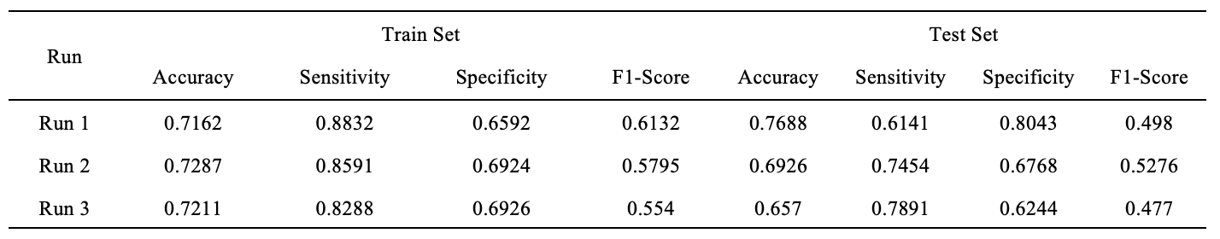
Graph Convolutional NetWORK (GCN)
Notes:
Hyperparameters optimized one at a time while others kept fixed for focused exploration.

Slide 28
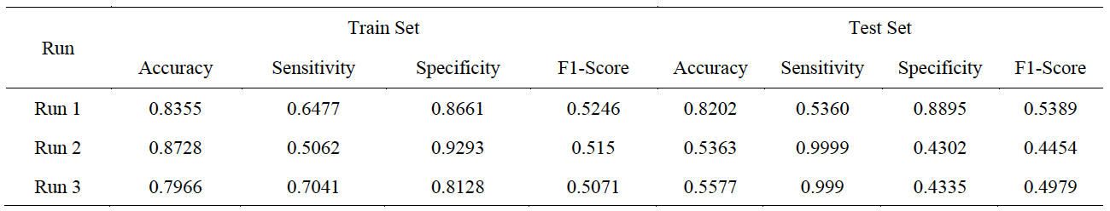
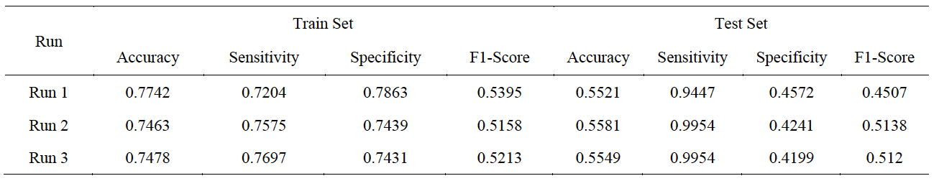
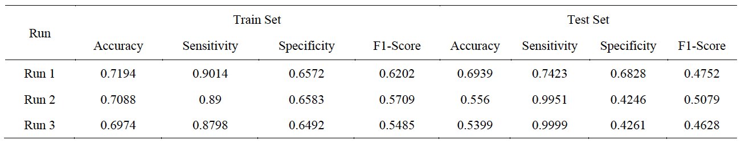
Graph ATTENTION NETWORK (GAT)
Notes:
Hyperparameters optimized one at a time while others kept fixed for focused exploration.

Slide 29
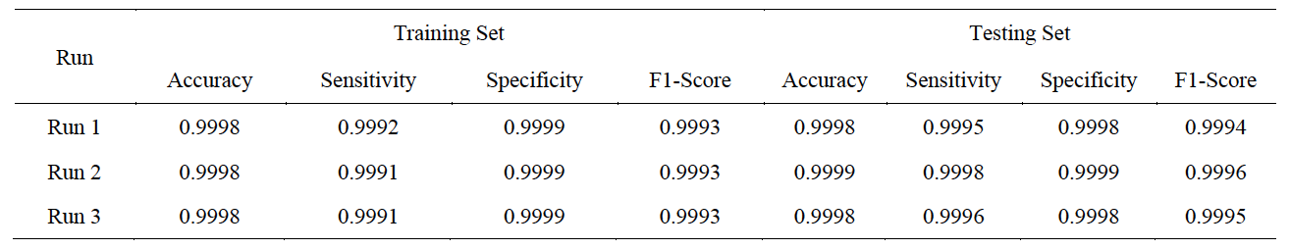
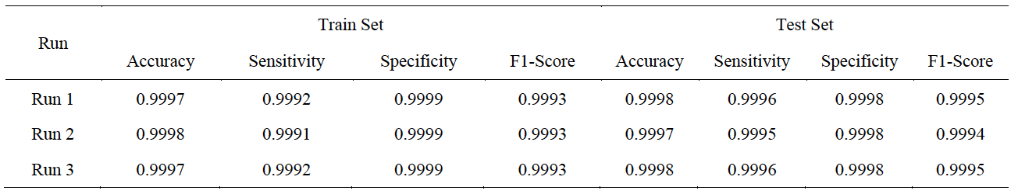
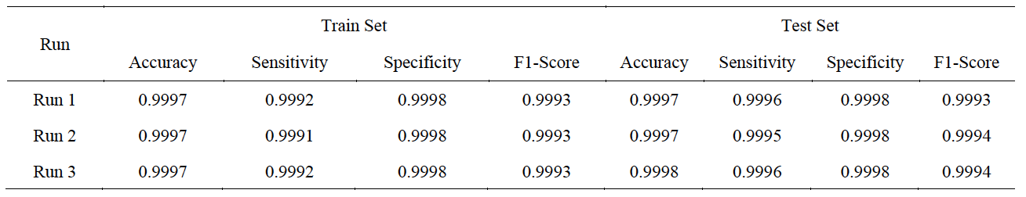
GraphSAGE
Notes:
Hyperparameters optimized one at a time while others kept fixed for focused exploration.

Slide 30
Discussion

Slide 31

Limitations of Data
Study foundation: Proximity assumption due to data constraints
Limitations: Incomplete capturing of interactions and lack of individual attributes
Data seemed simulated
Absence of timestamps limited context
Lack of specific virus/infection type data hampered model accuracy
Notes:
Reliance on proximity data for disease transmission understanding

Slide 32

Limitations of Methodology
Use of artificial labels due to absence of real infection status labels.
Reliance on simulation-based validation; need for real-world verification and applicability.
Concerns about research's robustness and generalizability across various real-world settings.
Notes:
Weighted consideration for loss
GCN: GCN convolutional layers
GAT: GAT convolutional layers with a specified number of heads
GraphSAGE: SAGE convolutional layers with number of samples parameters

Slide 33

FUTURE WORKS
Develop real-time adaptive models for changing interaction patterns utilizing real-time data feed
Create visualization tools for influential nodes/edges in Include immunity, vaccination, and environmental factors in models
Incorporate real-world data with labels for model validation
Notes:
Adaptive models
Enhanced intepretability
Multifactorial Modeling
Real-world Verification

